Slide 1
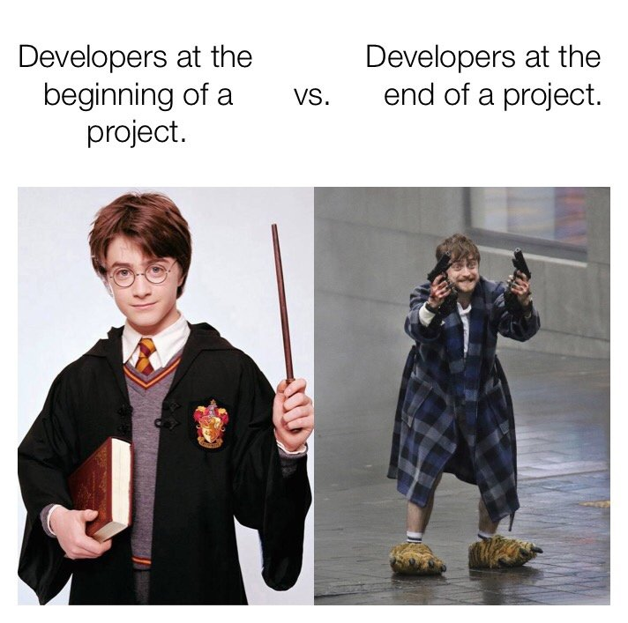
Edesia
Sprint Retrospective #10
Team Blue
Adam Bowers | Daniel Wingo | Stephen Bennett | Jonathan Holley
Github: aLotofAdam | 81wingo | stephenbennett2 | mccauley747
UNCG: ajbower3 | dtwingo | scbenne3 | jbholley

Slide 2
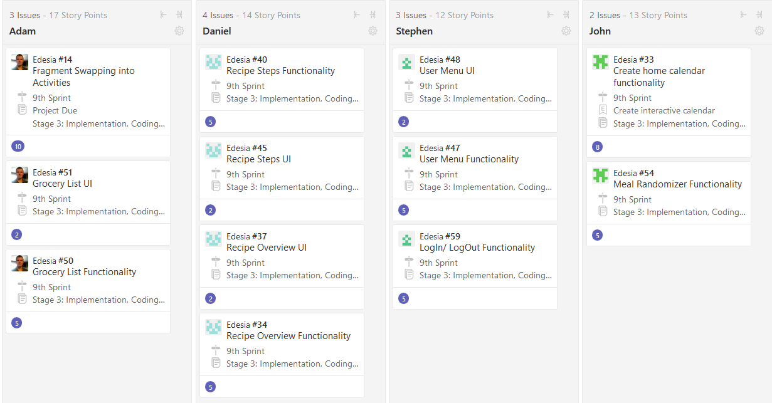
Last Sprint

Slide 3
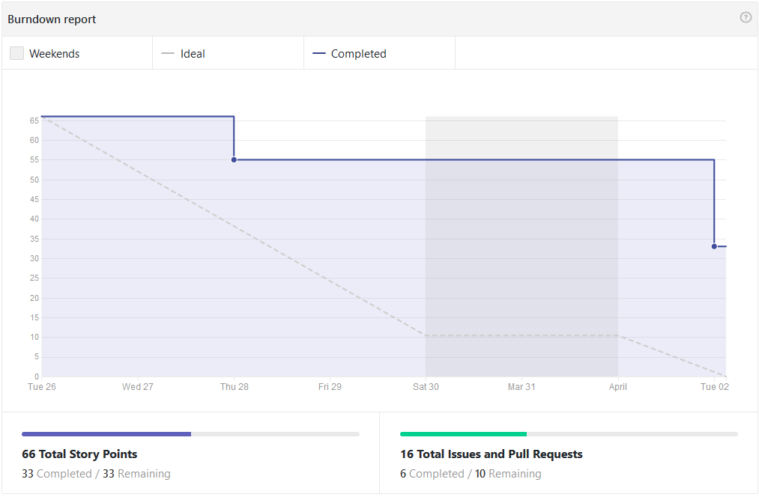
Burndown Chart

Slide 4
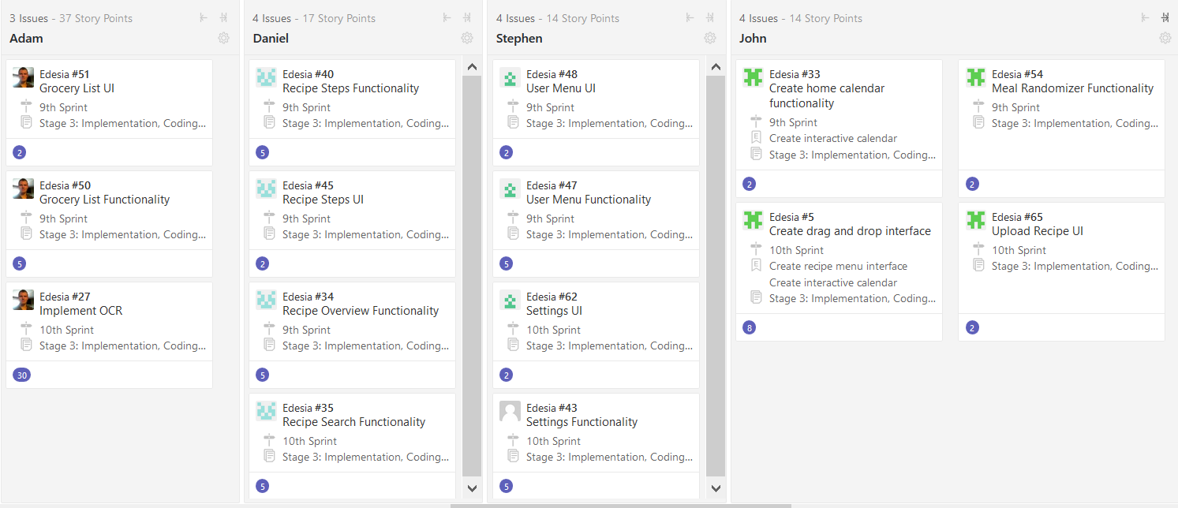
Current Sprint

Slide 5
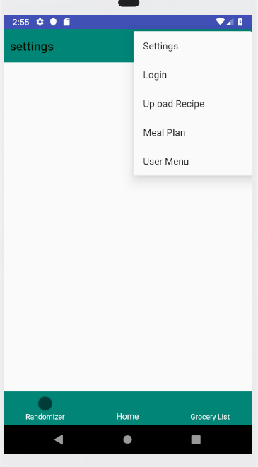
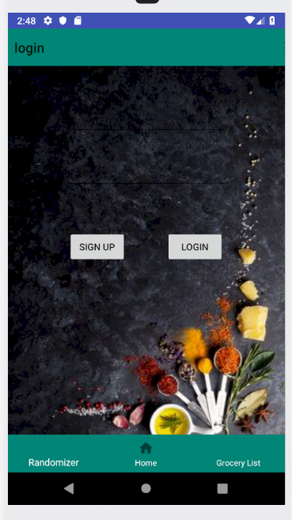
Android Studio
Buttons need names too
Navigation handles:
Animation transitions
Swaps fragments by actions
Bottom navigation and toolbar
Deep links
Back button
Passing data
Google OCR next...

Slide 6
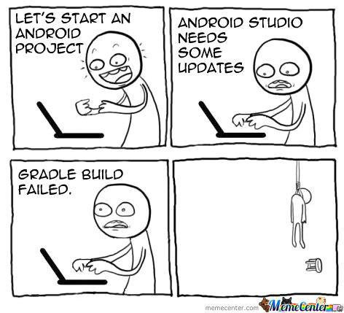
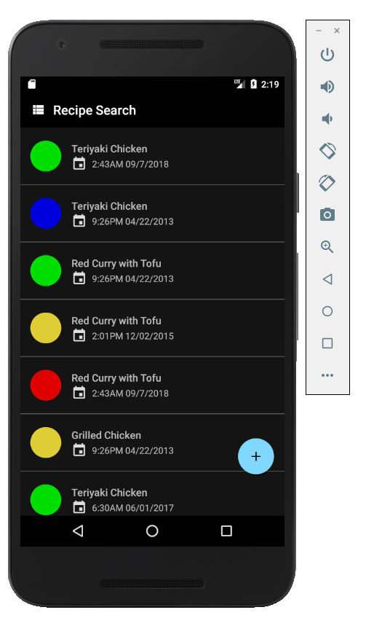
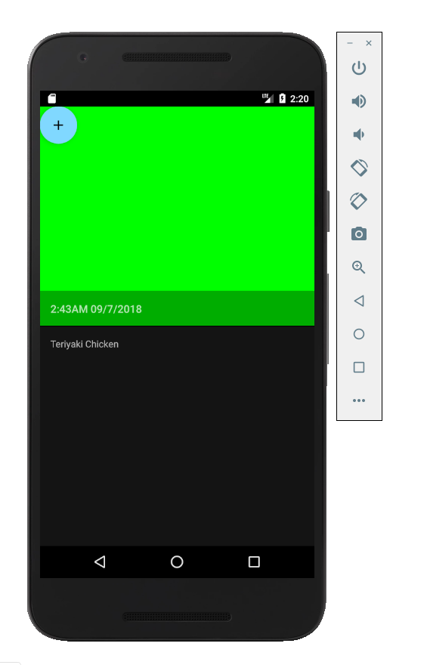
Recipe Pages for the app
GUI’s are done and most of the java page functionality
Working on database connections still..

Slide 7
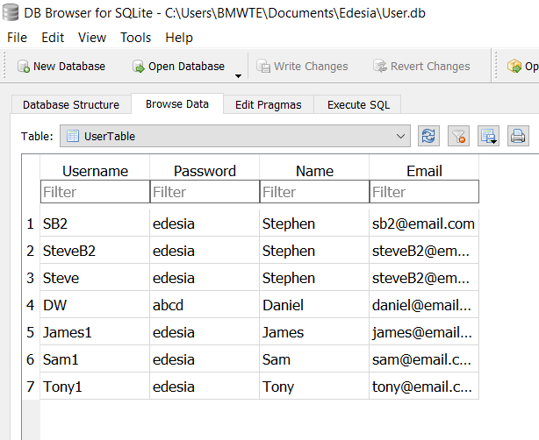
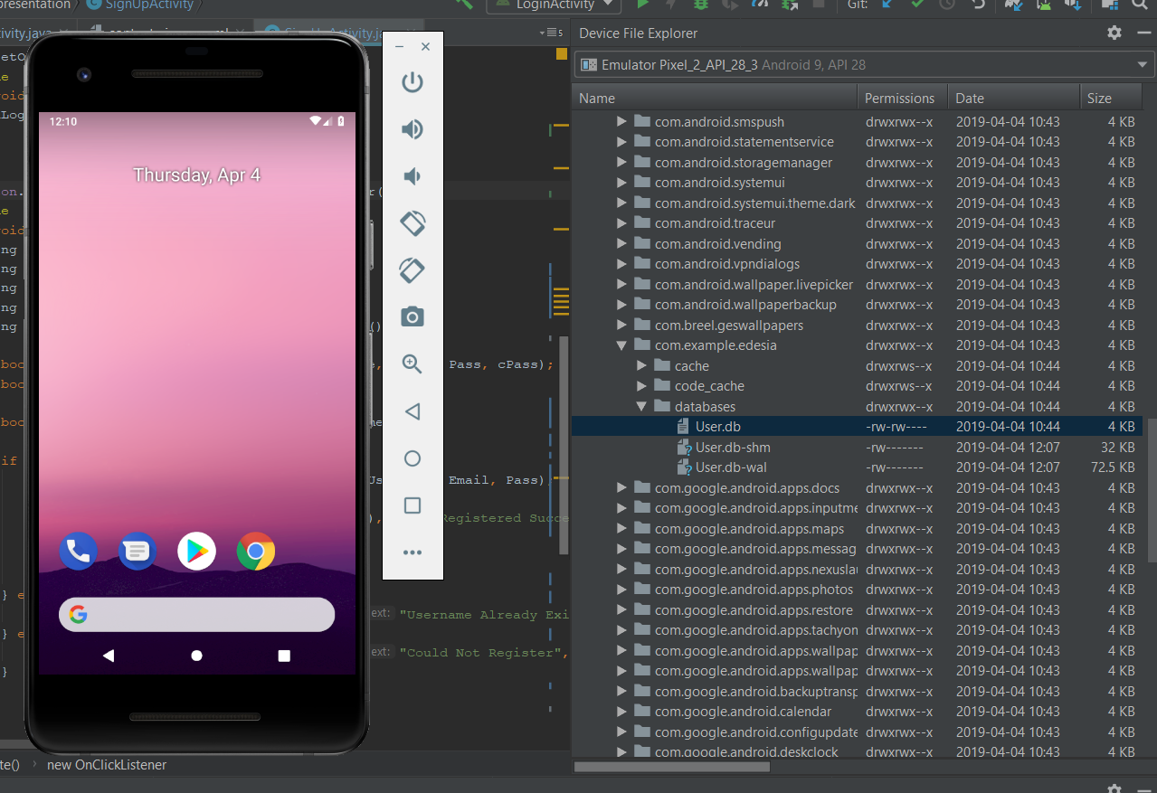
User Database
-Viewing userTable in DB browser imported from android emulator

Slide 8

User Login/Signup
Login/Register is working properly, mapping to database is all complete.
Error checks are in place
Next step is adding table to database for User specific recipe information (favorites, etc.) , and creating the User Menu page.

Slide 9
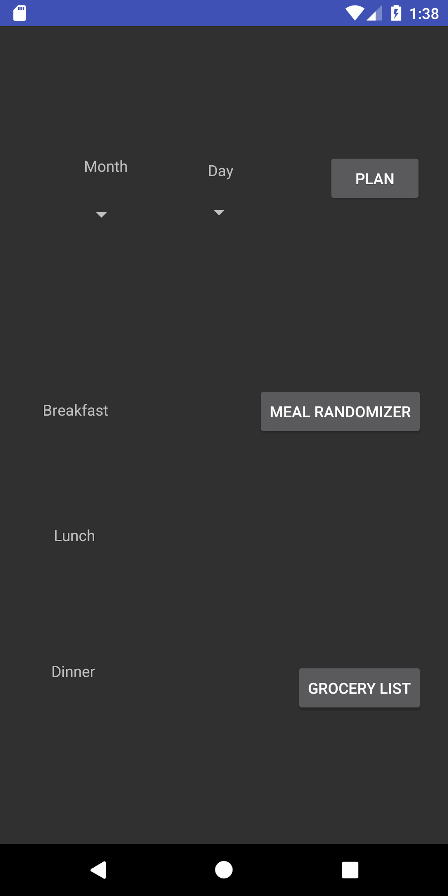
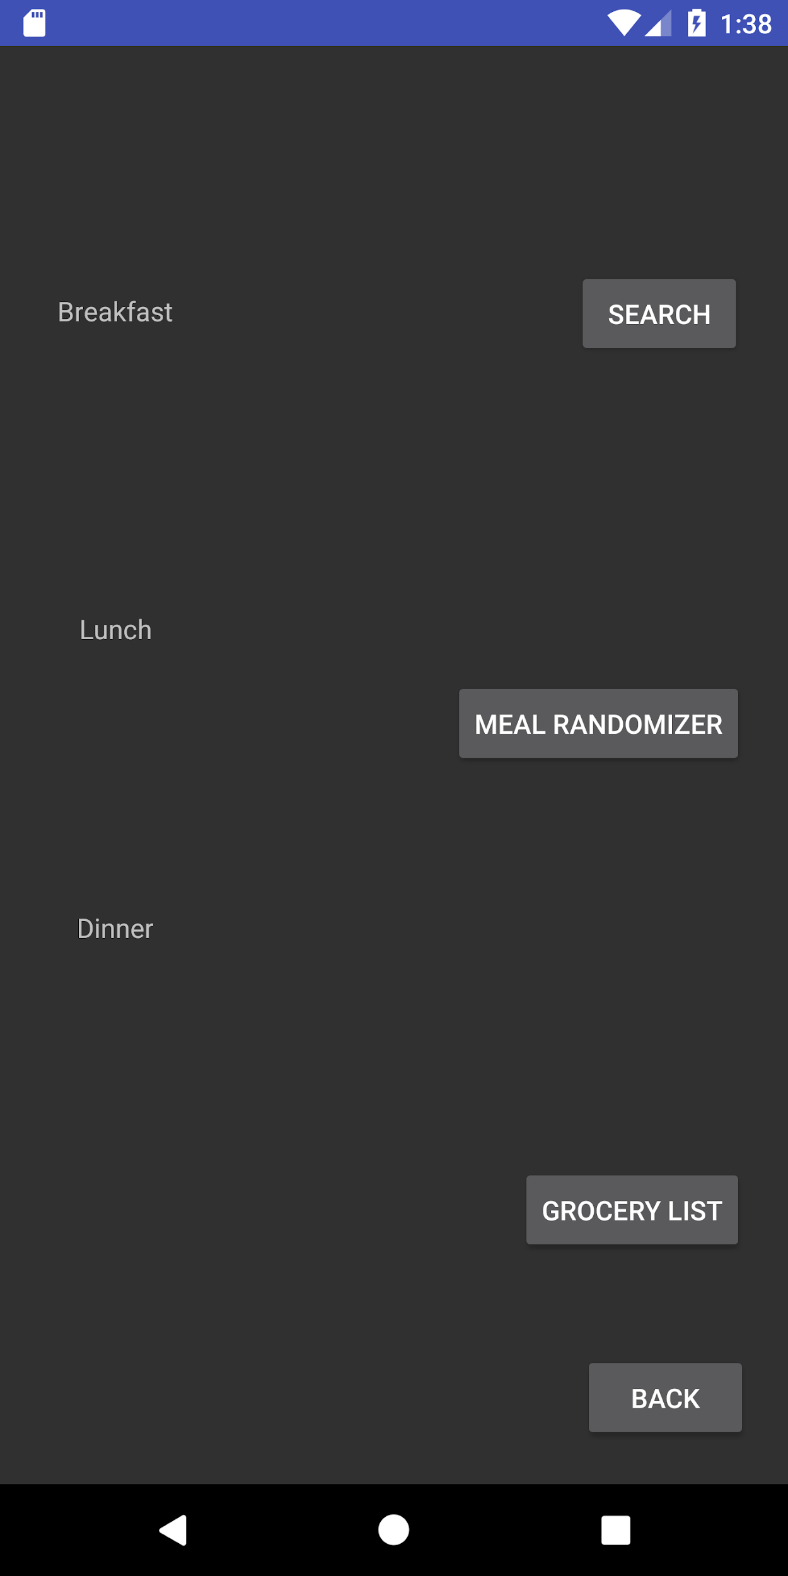
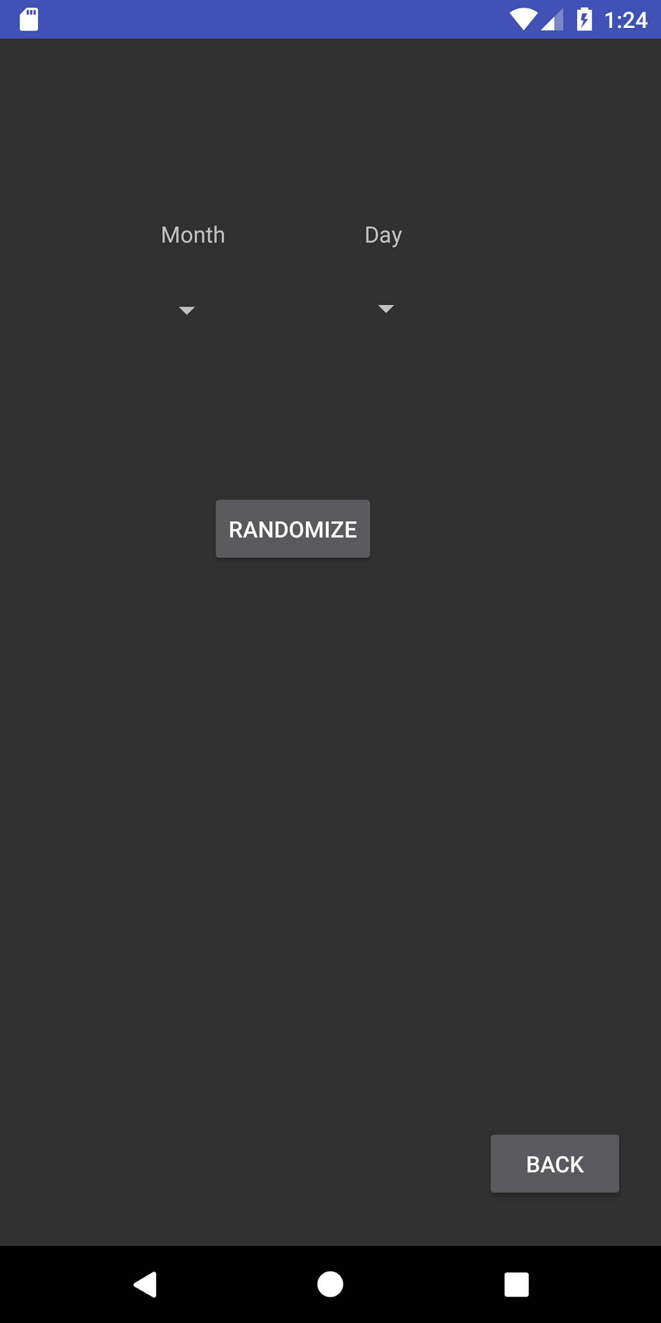

Slide 10
Calendar Subsystems
Navigation functionality nearly complete.
Drag and Drop is being worked on.
Randomizer is setup.
Next Step: Communication with Recipe Search.

Slide 11
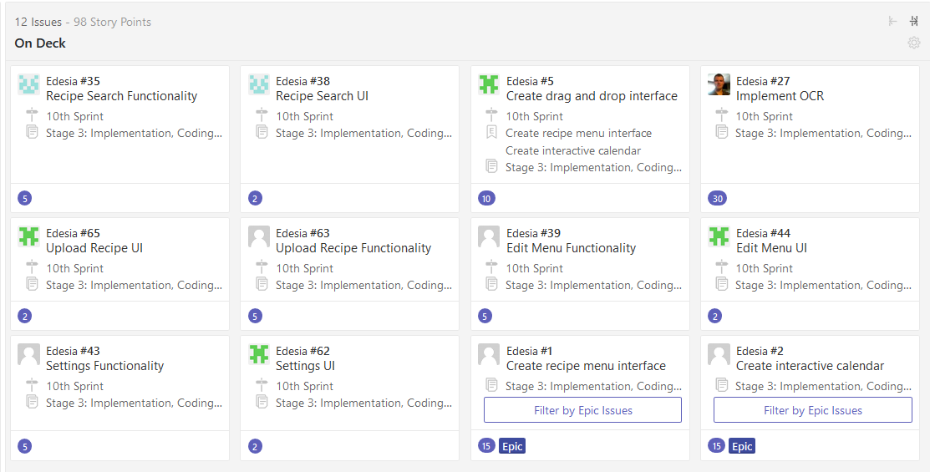
Next Sprint

